Slide 1
Alpha-Eng Platform – V1

Slide 2
Home Page

Slide 3



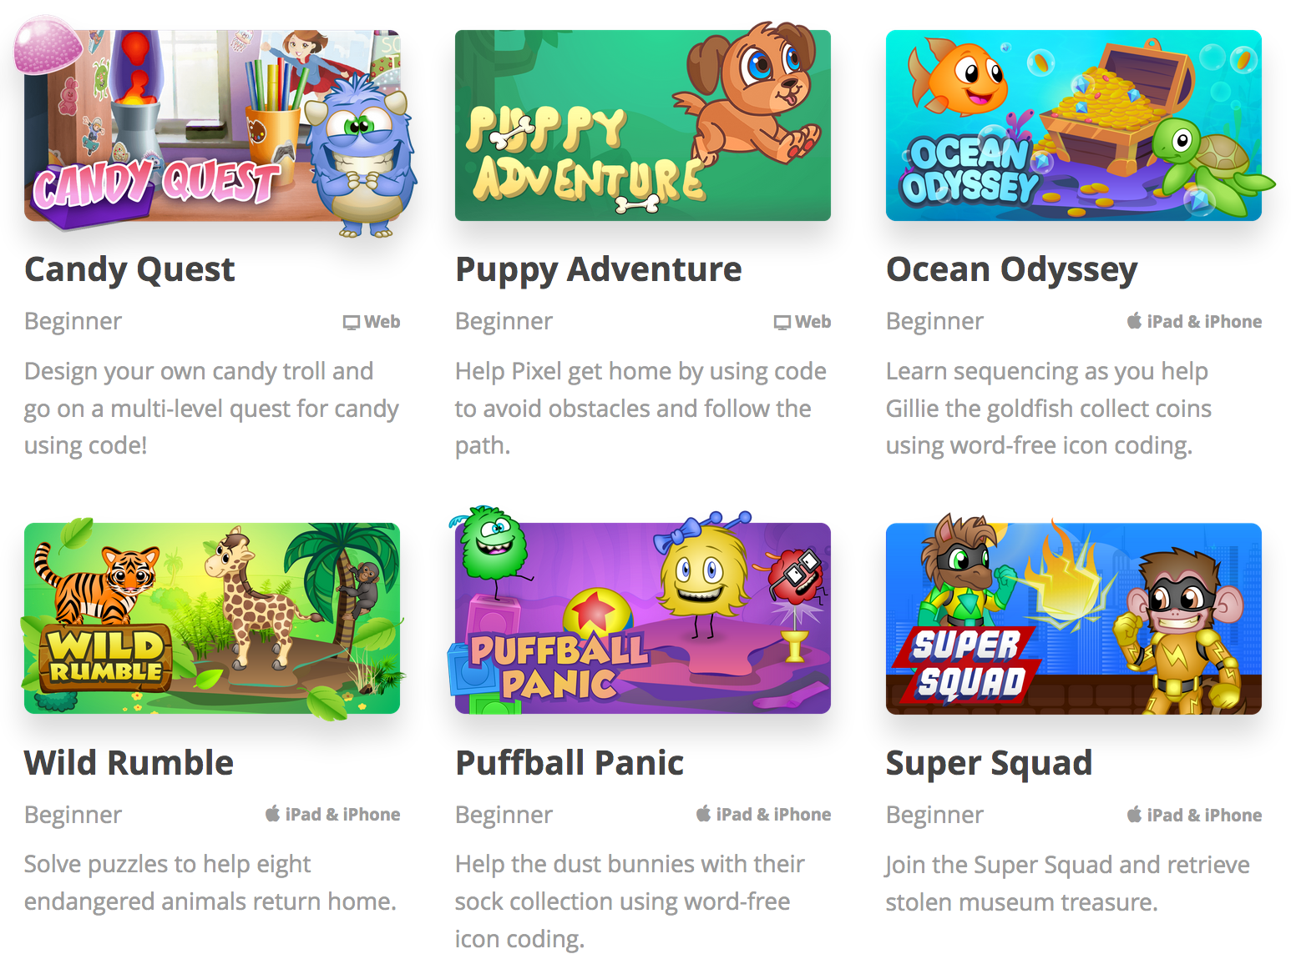
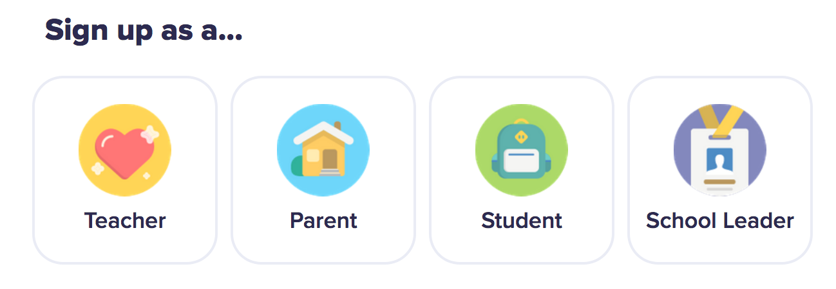
KOOSTEM
Class
PPT
Mini Game
Iive Stream
Log in
Inspire the education
Xxxxxxxxxxxxxxxxxxxxxxx
xxxxxxxxxxxxxxxxxxxxxxxxxxxxxxxxxxxxxxxx

Slide 4
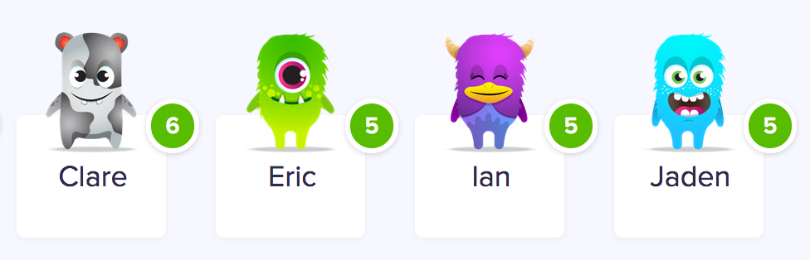

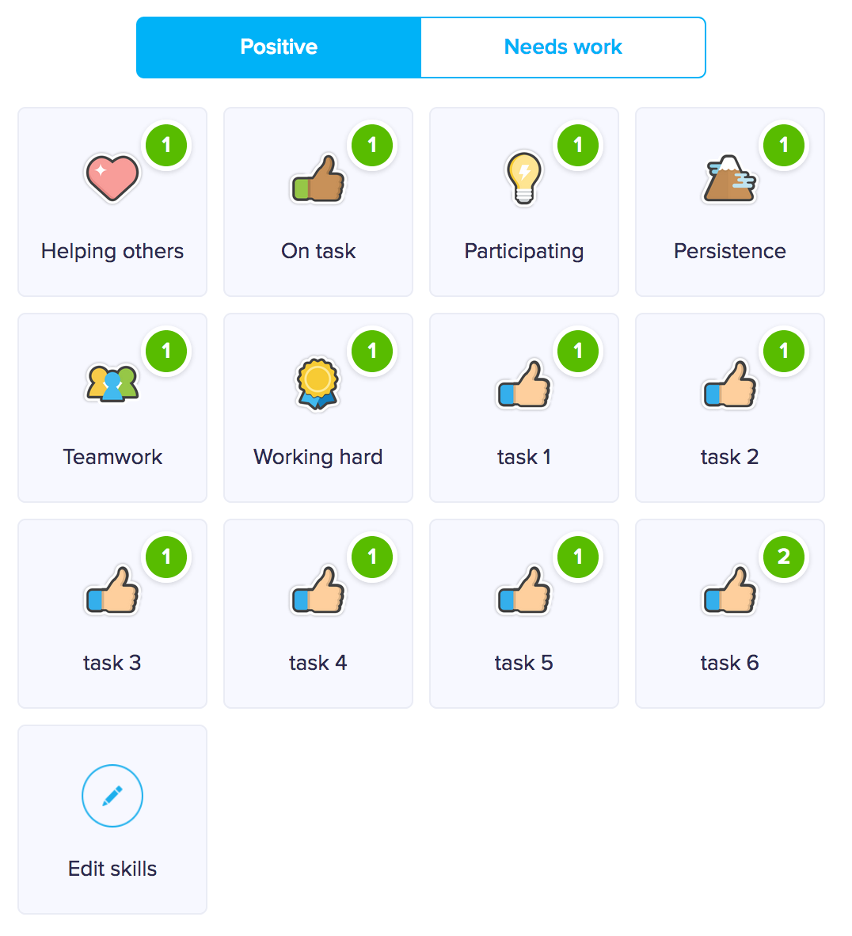
Class management tools

Slide 5
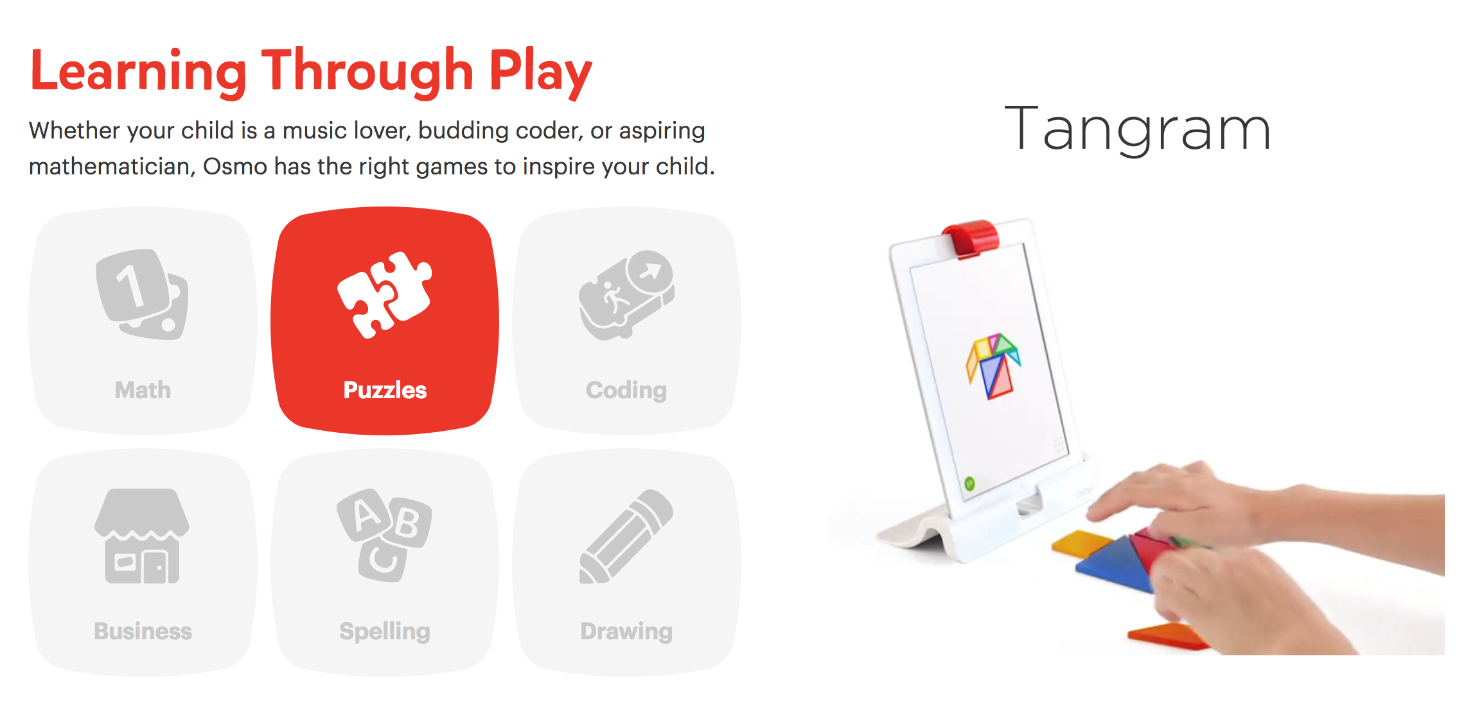
PPT games for English learning

Slide 6

Mini games for English learning

Slide 7
Teacher Login Page（Class）

Slide 8
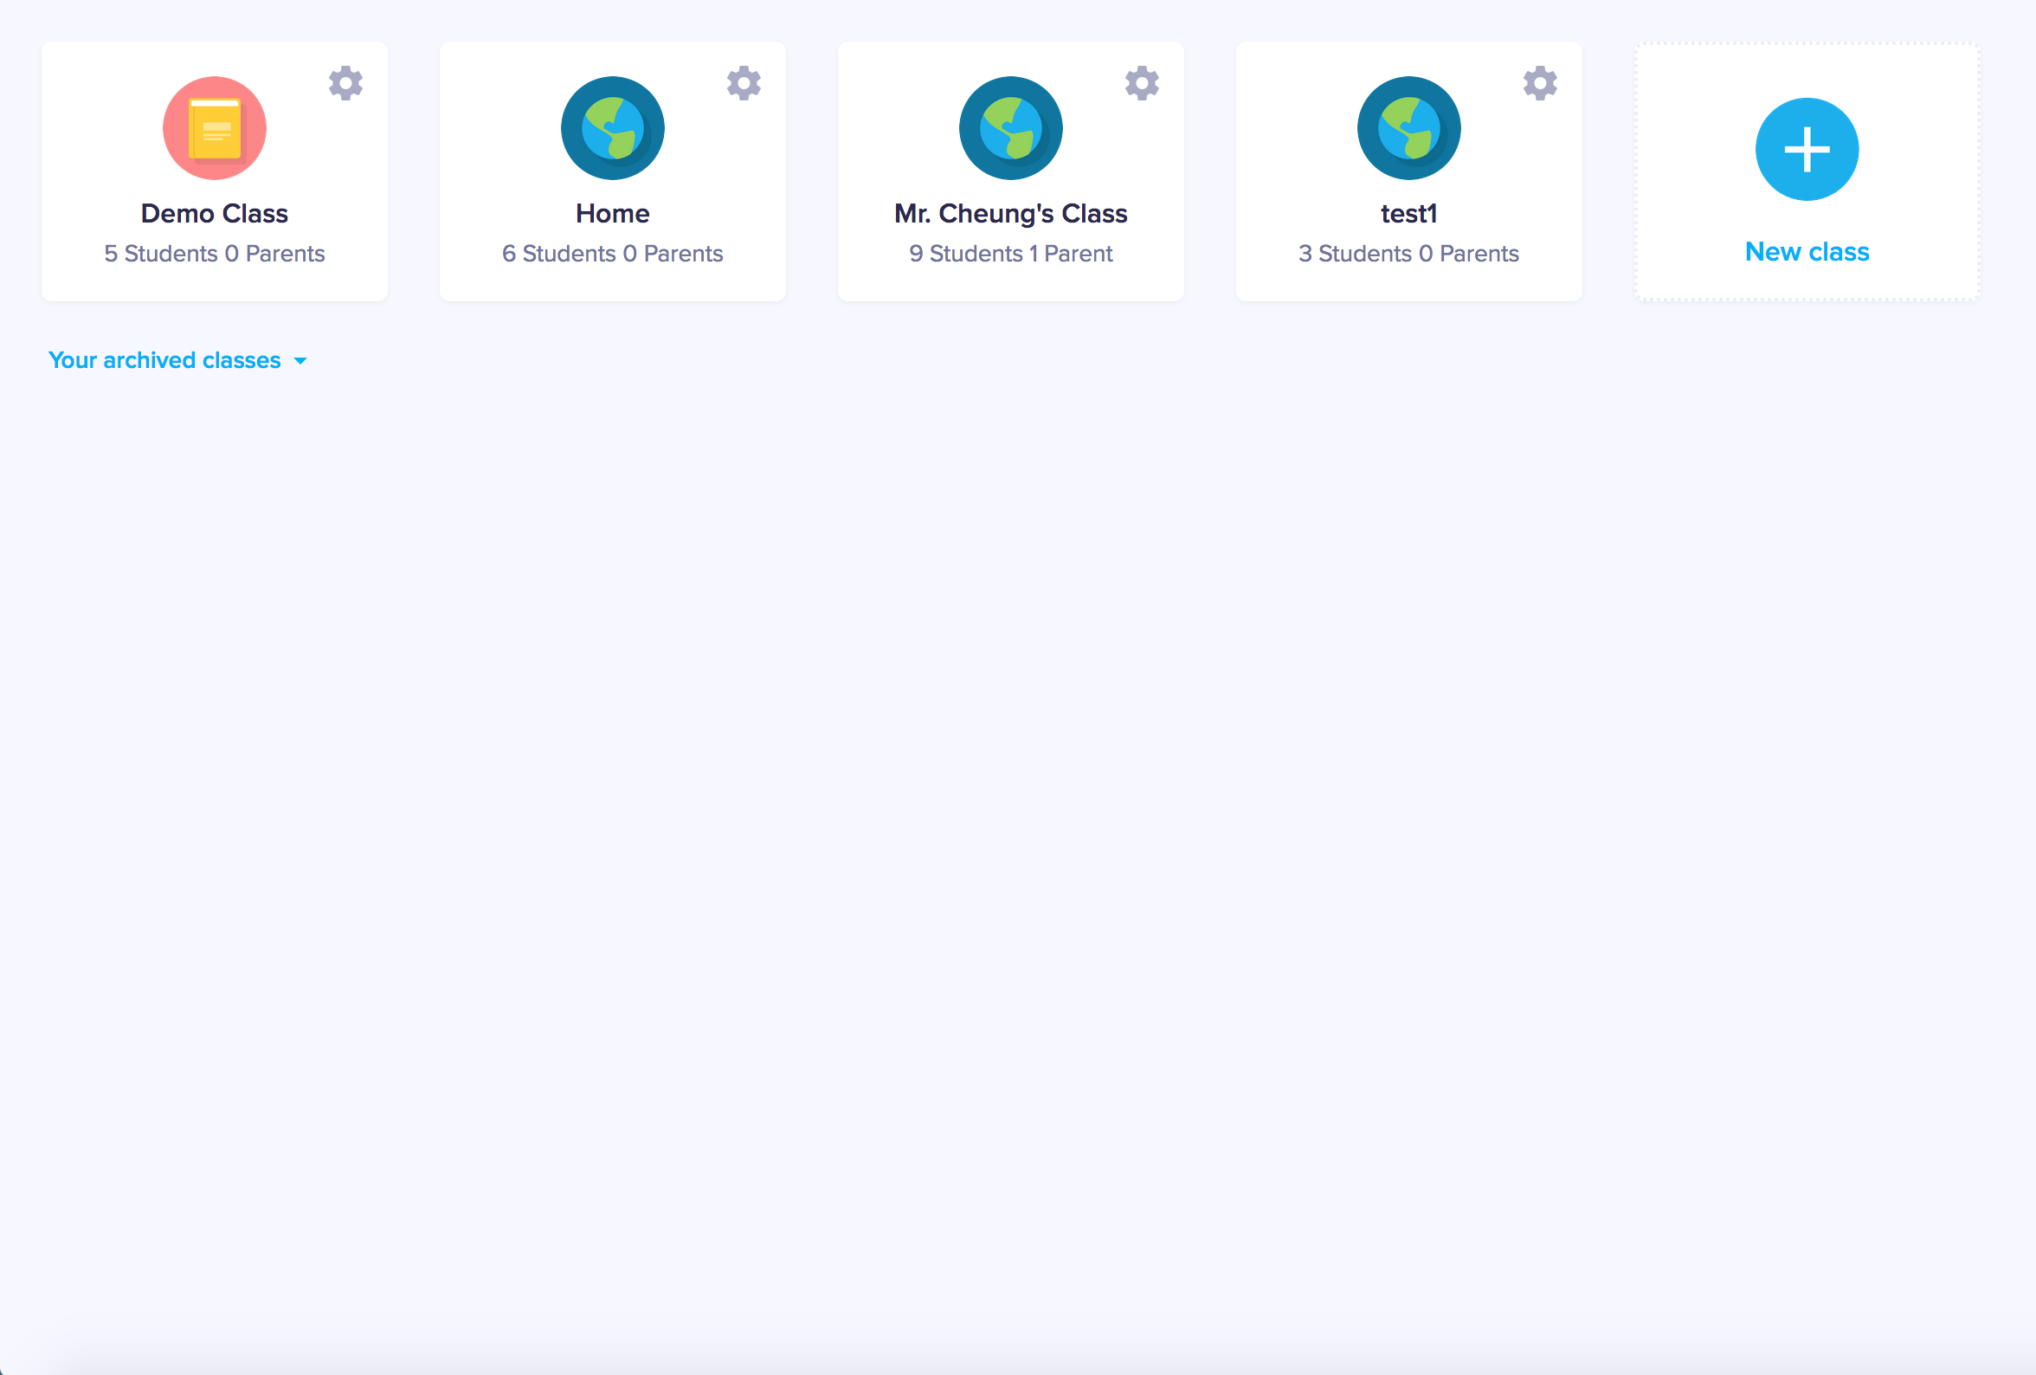

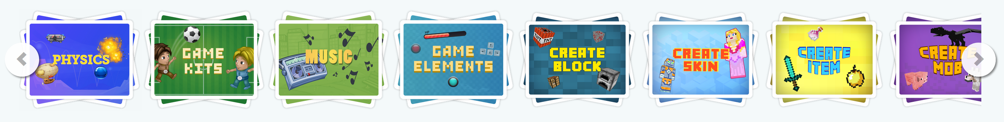

PPT games
Mini games

Slide 9
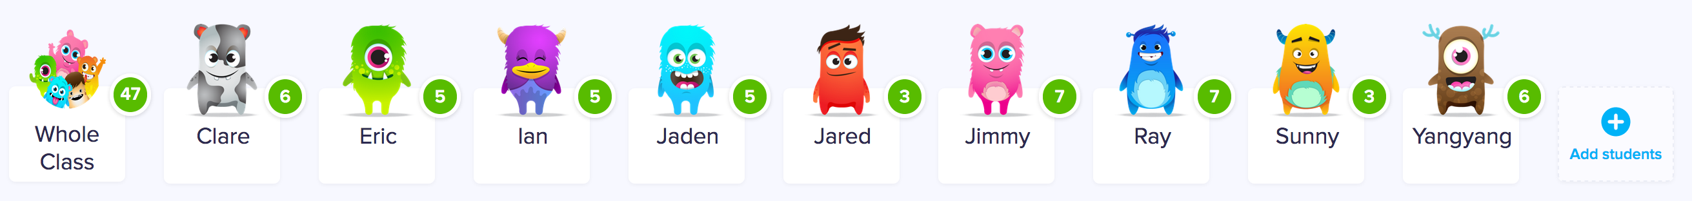
PPT games
Mini games

Slide 10
PPT Game Page

Slide 11

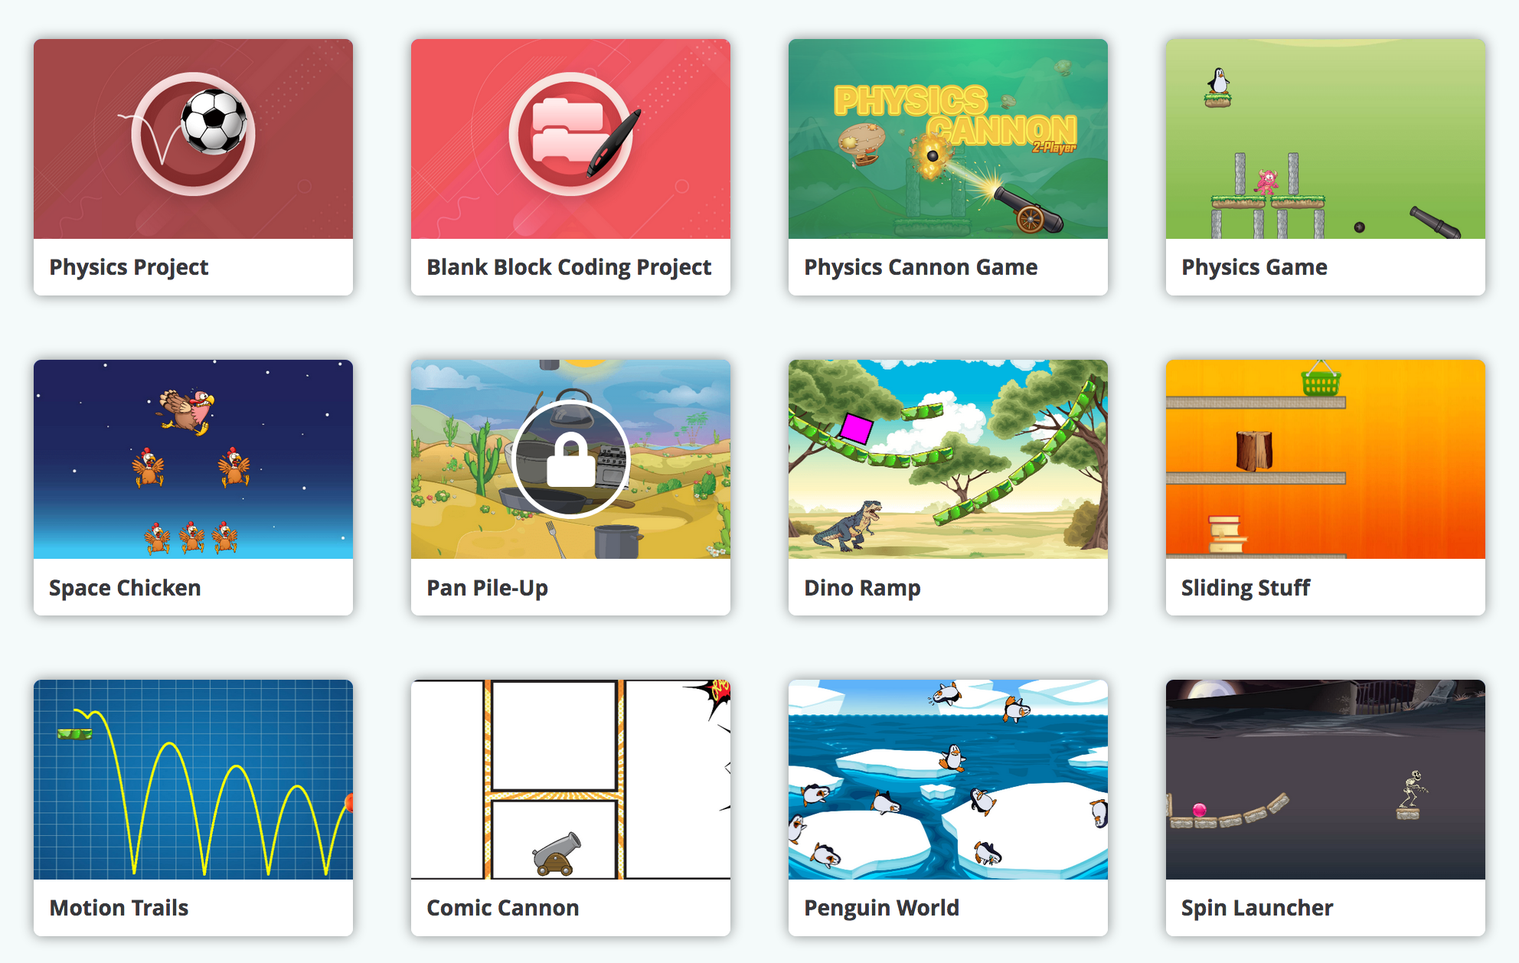
1 2 3 4 5 ……20

Slide 12
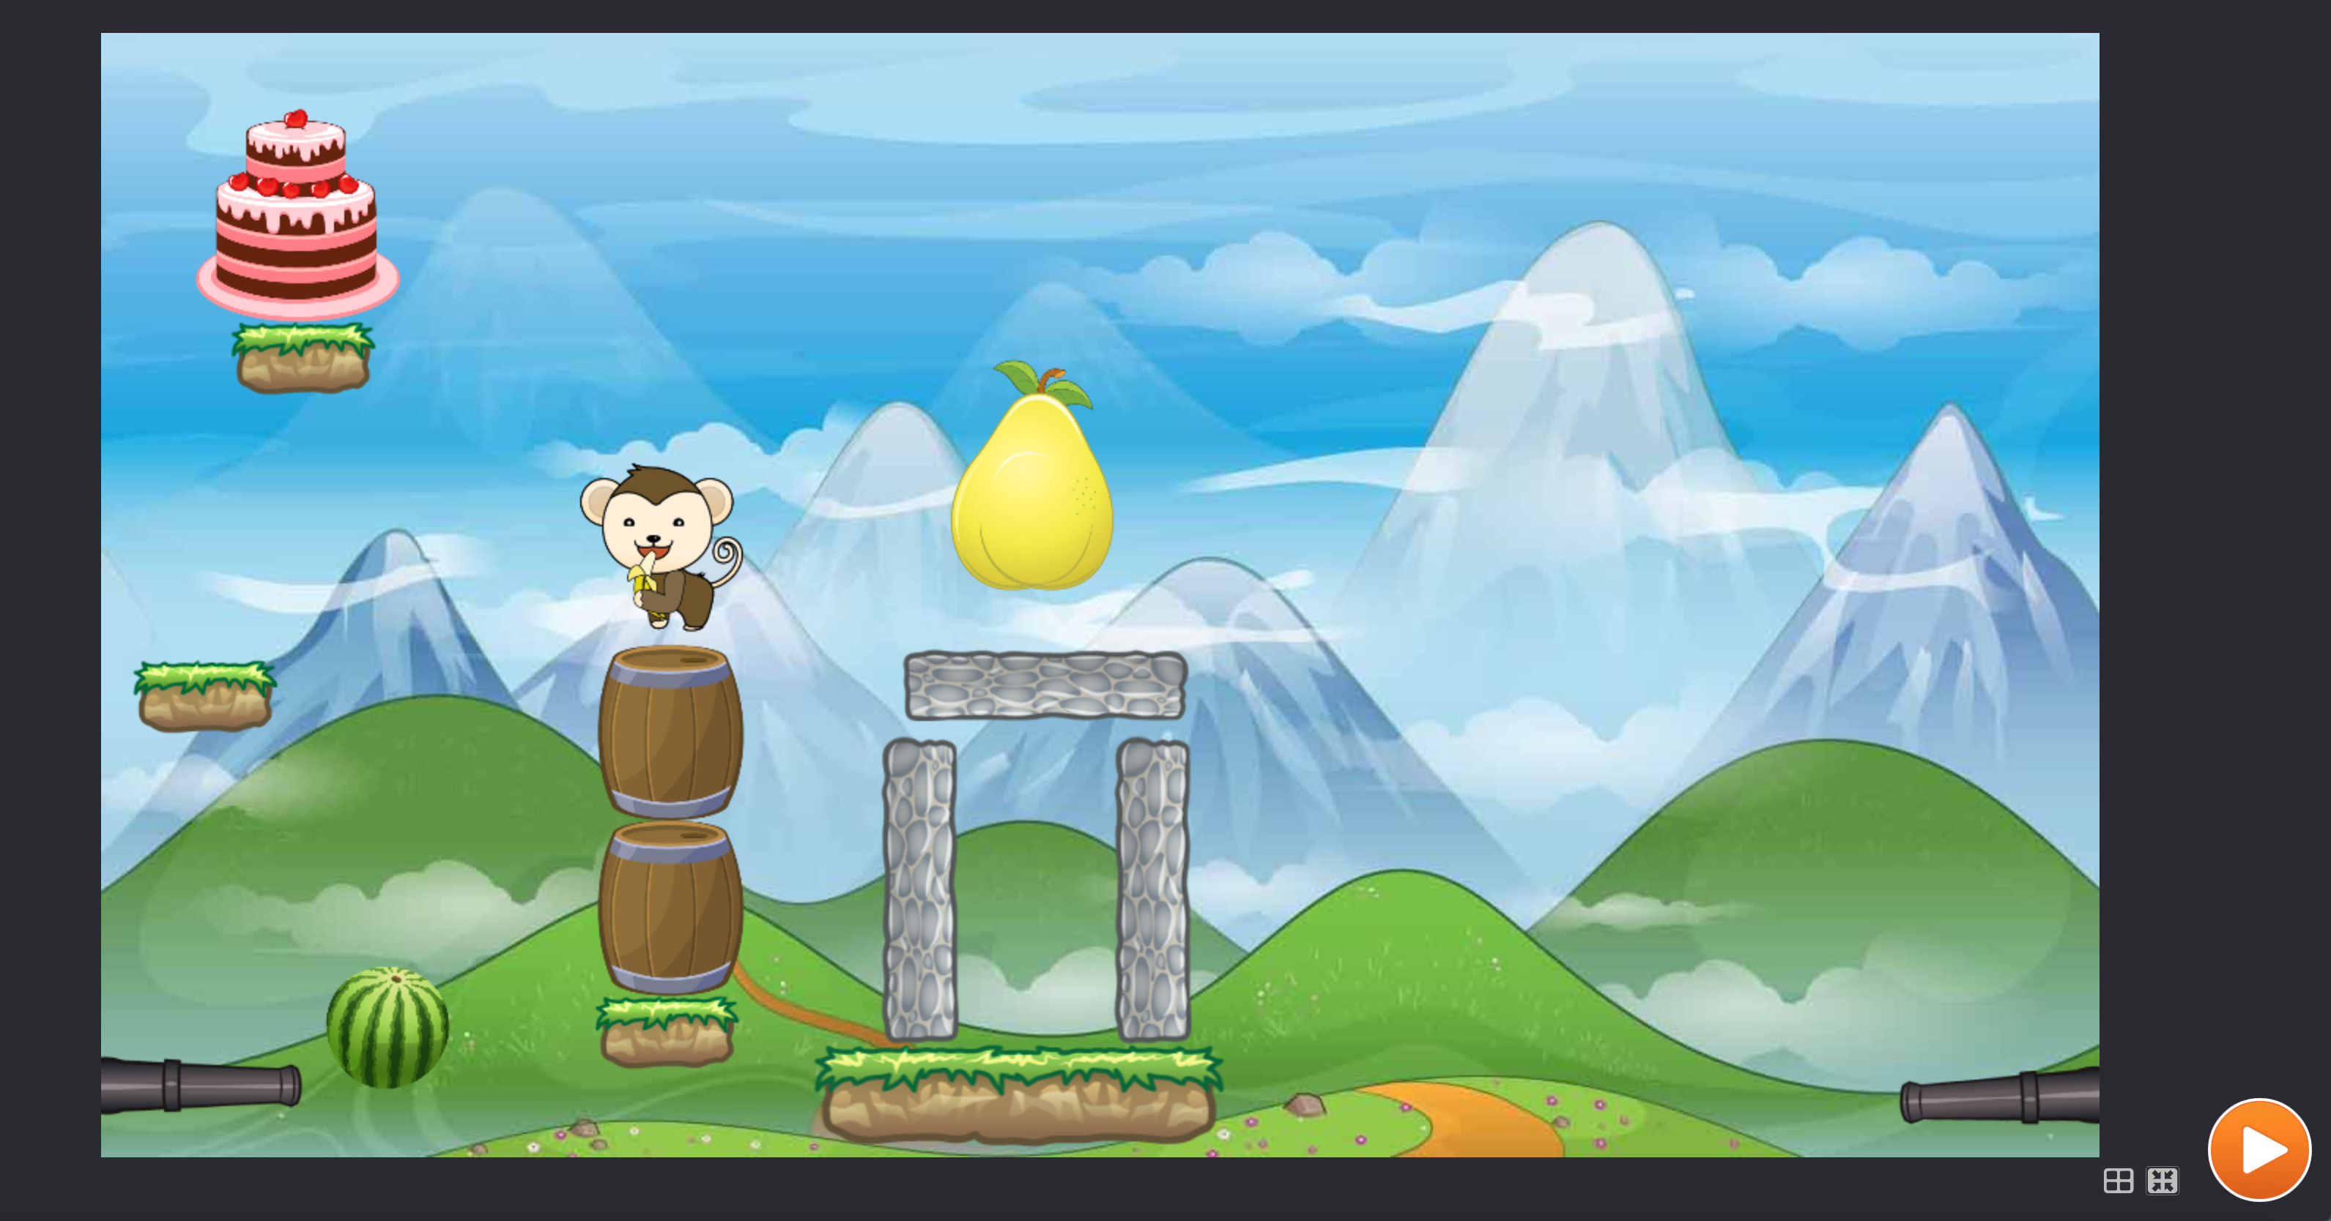
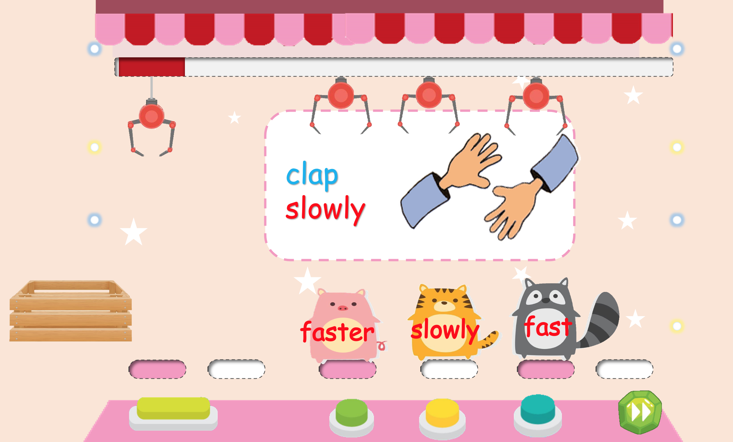

Slide 13
Mini Game Page

Slide 14
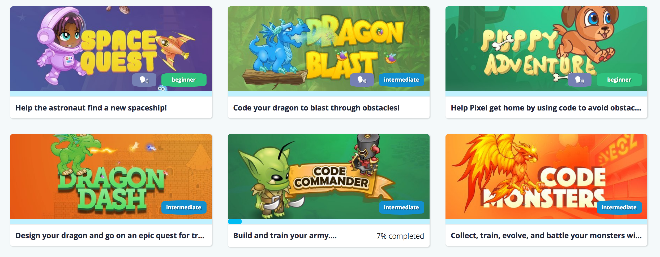

Slide 16
Live Stream Page

Slide 18
Sign Up Page

Slide 19
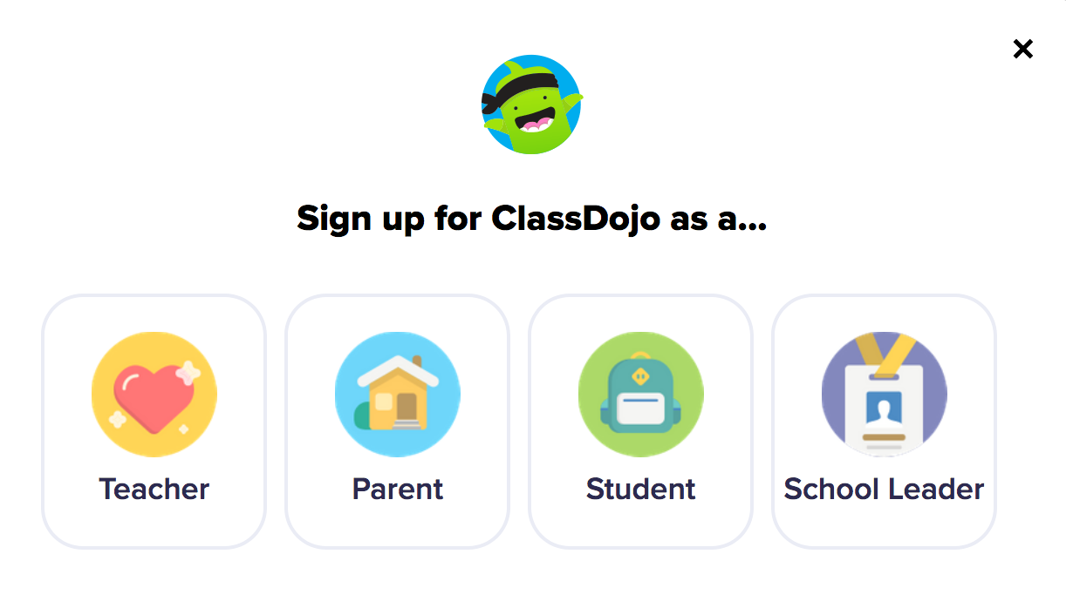
KOOSTEM
PPT
Mini Game
Iive Stream
Log in
Inspire the education
Xxxxxxxxxxxxxxxxxxxxxxx
xxxxxxxxxxxxxxxxxxxxxxxxxxxxxxxxxxxxxxxx

Slide 20
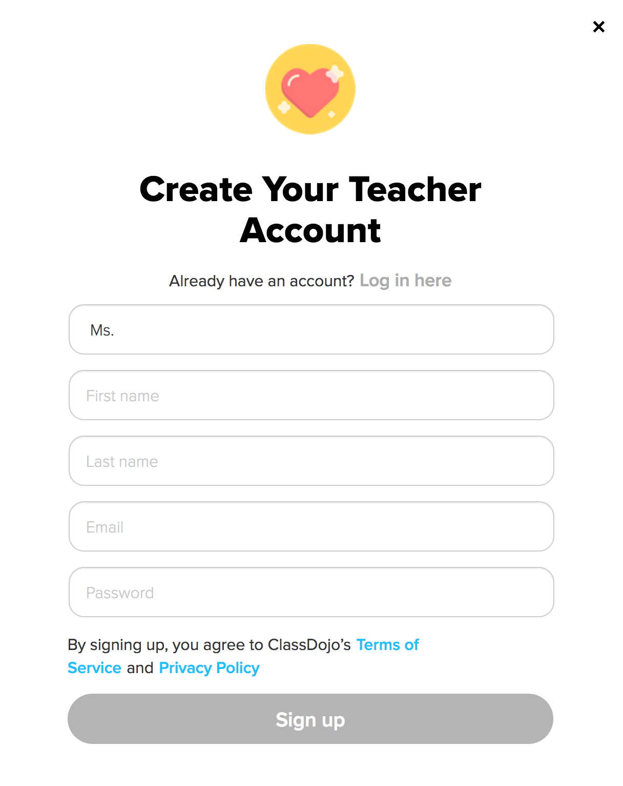
KOOSTEM
PPT
Mini Game
Iive Stream
Log in
Inspire the education
Xxxxxxxxxxxxxxxxxxxxxxx
xxxxxxxxxxxxxxxxxxxxxxxxxxxxxxxxxxxxxxxx

Slide 21
Student Login Page

Slide 22

PPT games
Mini games

